Slide 1
Thin film deposition (1/2)

Slide 2
Introduction
Many layers are needed in an IC process flow above the silicon substrates.
We are interested in:
Film quality, i.e.:
  Composition
  Mechanical/electrical properties
  Defectivity and contamination levels
Film thickness control
  From deposition to deposition
  Within wafer
  As a function of wafer topology

Slide 3
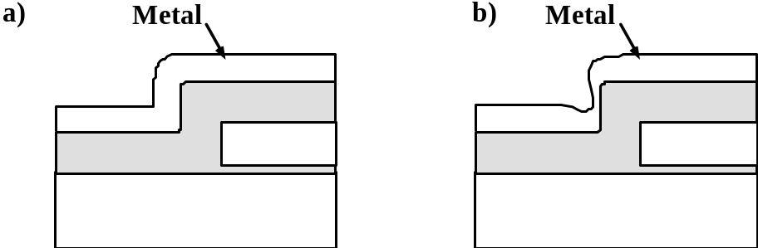
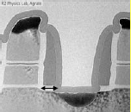
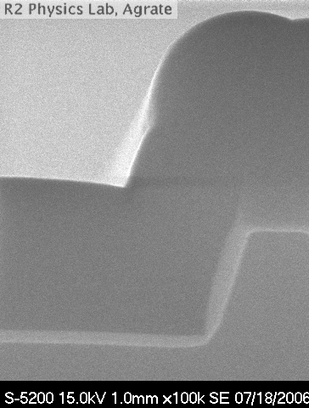
Step coverage and gap filling properties
Step coverage ( conformality)
The property of showing a constant thickness on horizontal and vertical surface

Slide 4
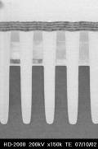
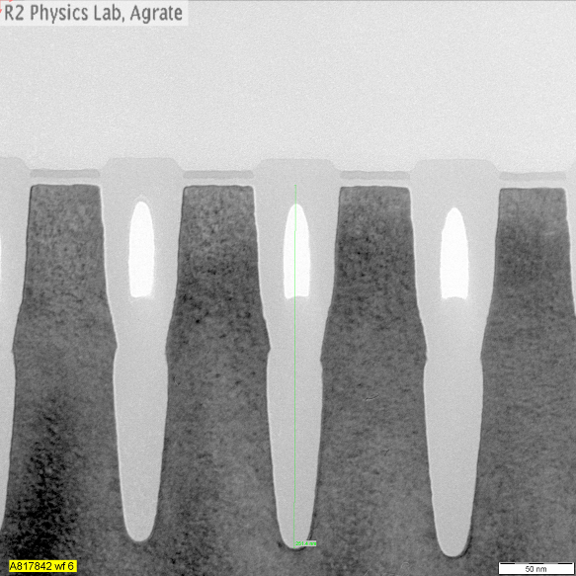
Gap filling and aspect ratio
Gap filling
The property of filling high aspect ratio structures

Slide 5
Thin film deposition methods
CVD (Chemical Vapour Deposition)
  Reactant gases are introduced in the deposition chamber
  Film deposition id produced by chemical reaction between gases at wafer surface.
PVD (Physical Vapour Deposition)
  Physical methods are used to produce constituent atoms that deposit on the wafer surface
    Evaporation
    Sputtering
Other techniques
  Liquid coating + solidification (e.g. Photo-resist, SOD)
  Electrolytic deposition (Cu)

Slide 6
CVD Techniques

Slide 7
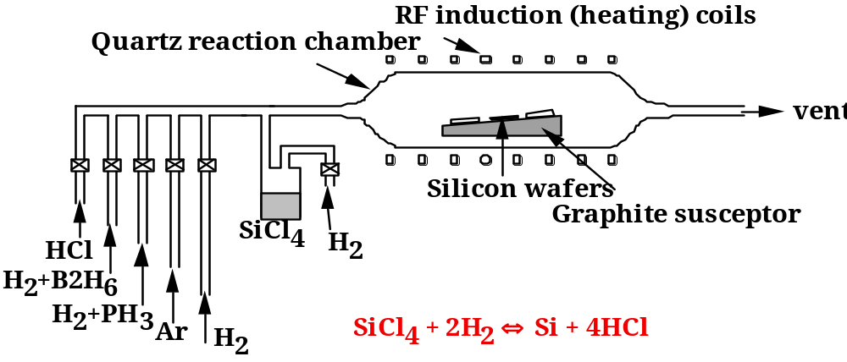
A simple CVD system: APCVD
Wafers are hold on heated susceptors, and reactant gases flow in the chamber at atmospheric pressure
APCVD has been widely used , especially for Epitaxial Si deposition.
Almost abandoned in modern IC manufacturing

Slide 8
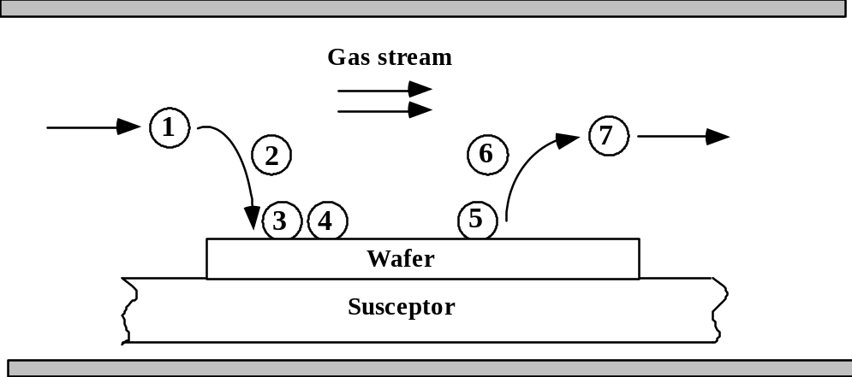
Basic mechanism in a APCVD chamber
Transport of reactants to the deposition region.
Transport of reactants from the main gas stream through the boundary layer to the wafer surface.
Adsorption of reactants on the wafer surface.
Surface reactions, including: chemical decomposition or reaction, surface migration to attachment sites (kinks and ledges); site incorporation; and other surface reactions (emission and re-deposition for example).
Desorption of byproducts.
Transport of byproducts through boundary layer.
Transport of byproducts away from the deposition region.
We will not consider:
Gas-phase reactions
Details of Surface migration/diffusion/re-emission
We will concentrate on:
Step 2 (mass transfer) and step 3-5 (surface reactions)

Slide 9
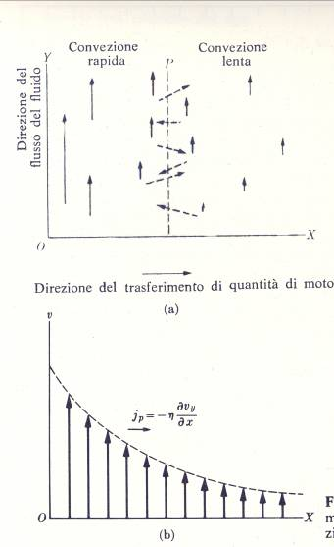
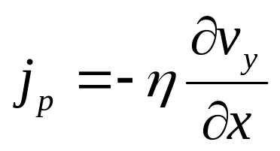
Basic transport mechanisms
A fluid with a convection current in the Y direction:
Non uniform speed along x
A Fick-like law can be written for momentum transfer
Viscosity
Momentum flux
Notes:
Dal momento che il fluido a destra e sinistra del piano P acquistano e perdono rispettivamente quantita’ di moto, si puo’ affermare che il fluido di destra e’ soggetto ad una forza nella direzione del flusso ( e quello di sinsitra ad una forza uguale e contraria). Lo sofrzo ( forza per unita’ di superficie) e’ proprio uguale a Jp.
Conservazione dell’energia nel vlumetto di superficie S e lunghezza dx

Slide 10
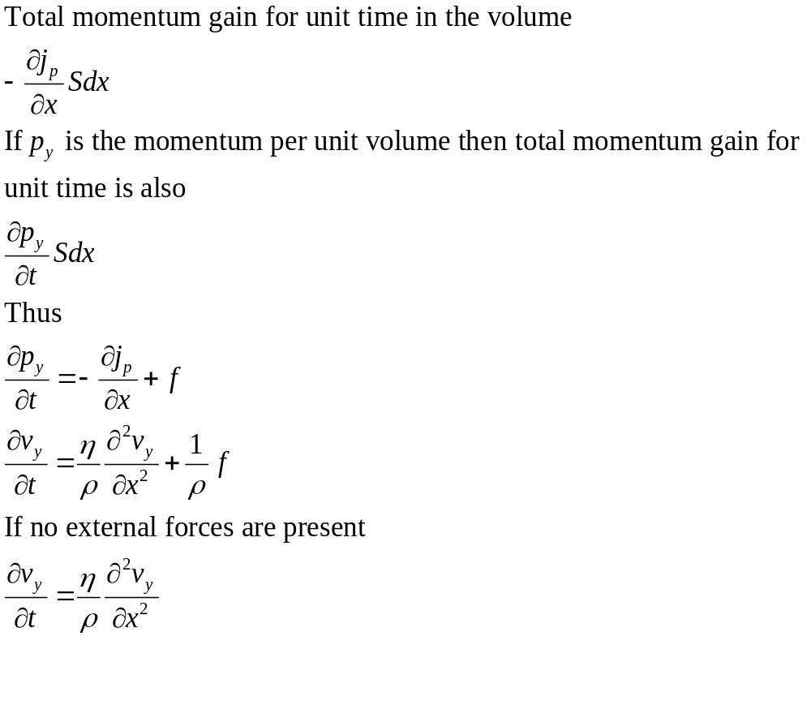
Basic transport mechanisms
v_{y}
S
j_{p}
j’_{p}
dx
Very similar to second Fick’s law
Notes:
La penultima e’ l’equazione del moto viscoso, ed esprime la conservazione della quanjtita’ di moto in un sistema viscoso.

Slide 11
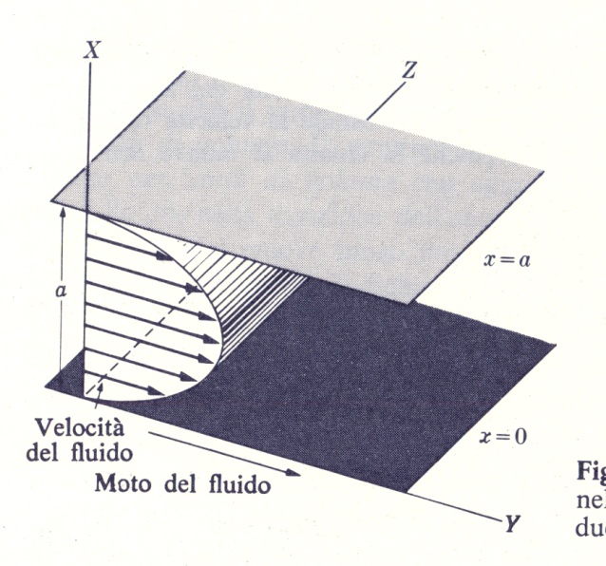
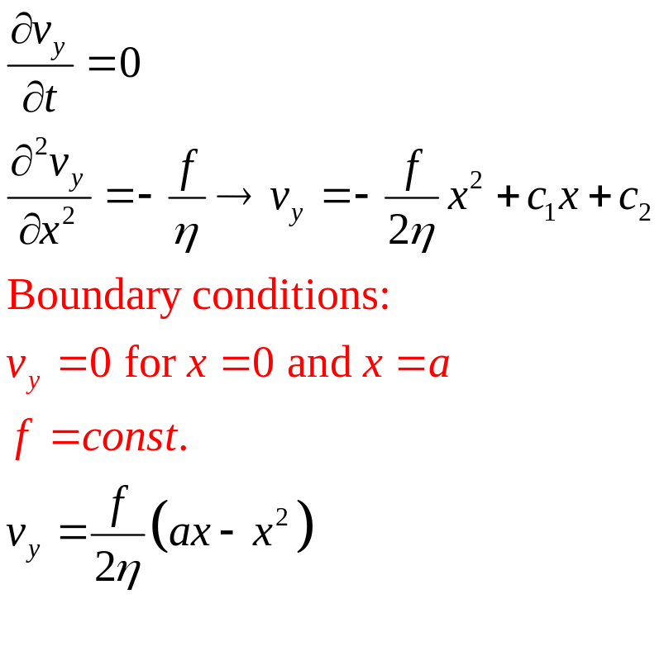
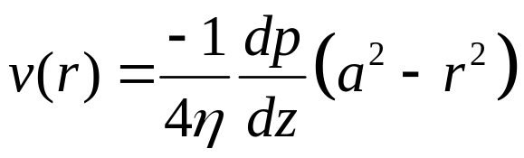
A simple example
Fluid motion between parallel plates in stationary condition.
For a tube of radius a, it can be demonstrated (in a similar way) that:
z
a
Where we chose the force f to be the pressure gradient in the tube

Slide 12
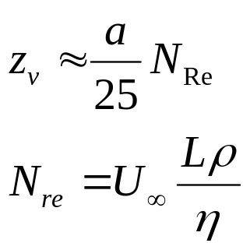
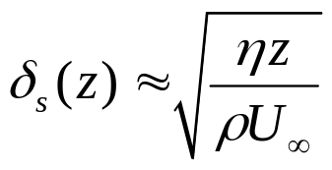
Boundary or stagnant layer
If a “plug” flow (i.e. with a uniform velocity U∞) is inserted in a tube, it changes from uniform to parabolic over a distance
Characteristic length of the chamber (e.g. radius a)
Reynolds number
If N_{re} is large enough (but not to induce turbulent flow) broad regions of the gas flow have approx. uniform velocity U∞. The velocity profile can be thus approximated as constant along r, apart form a boundary or stagnant layer δ, where the flow is 0.
It can be demonstrated that

Slide 13
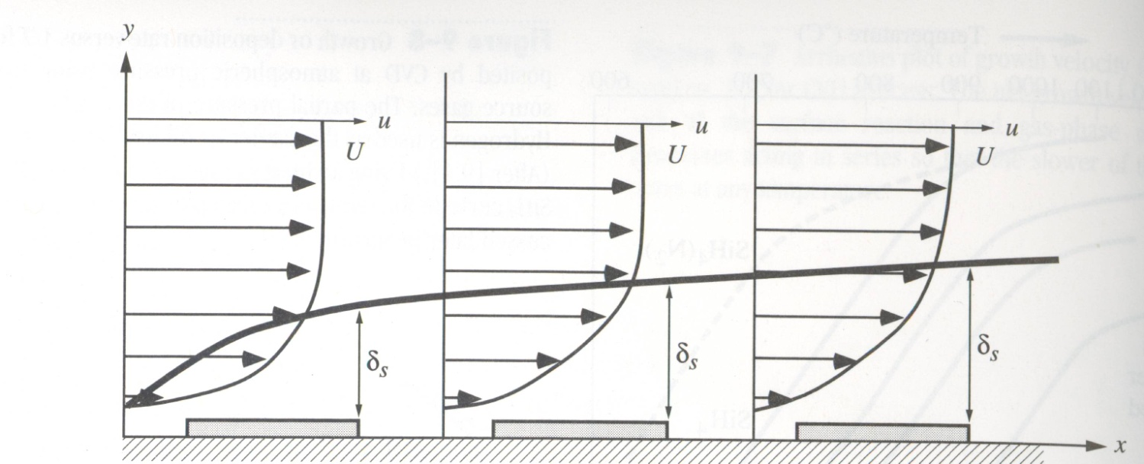
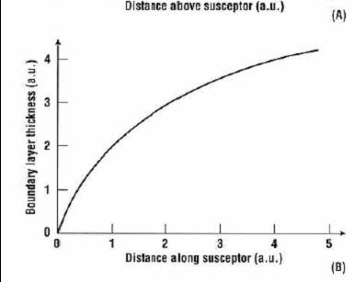
Boundary or stagnant layer

Slide 14
Basic mechanism in a APCVD chamber
Transport of reactants to the deposition region.
Transport of reactants from the main gas stream through the boundary layer to the wafer surface.
Adsorption of reactants on the wafer surface.
Surface reactions, including: chemical decomposition or reaction, surface migration to attachment sites (kinks and ledges); site incorporation; and other surface reactions (emission and re-deposition for example).
Desorption of byproducts.
Transport of byproducts through boundary layer.
Transport of byproducts away from the deposition region.
We will not consider:
Gas-phase reactions
Details of Surface migration/diffusion/re-emission
We will concentrate on:
Step 2 (mass transfer) and step 3-5 (surface reactions)

Slide 15
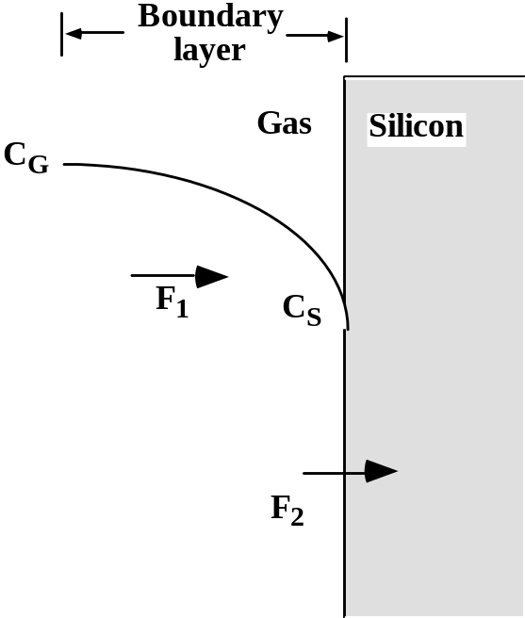
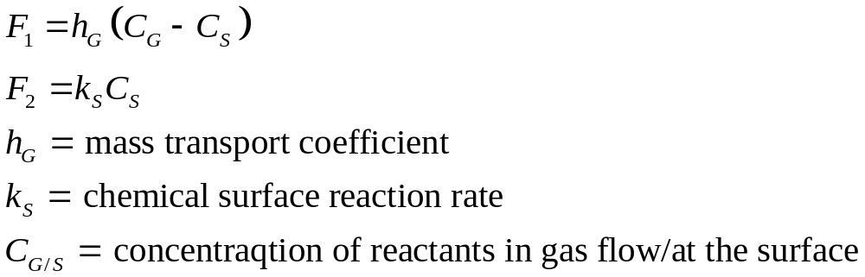
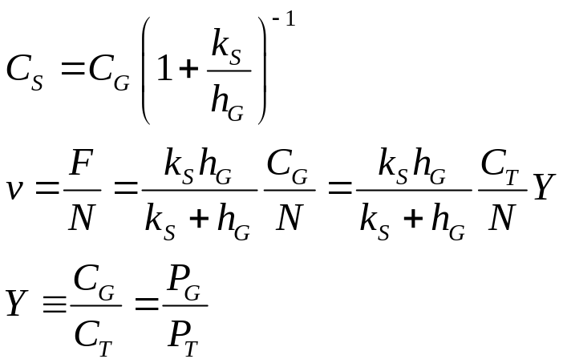
Flux equations for APCVD
Since F₁=F₂ we can write
N = density (number of atoms incorporated per unit volume)
Y= molar fraction
C_{T}=total concentration of gaseous species
P_{g},P_{T} = partial pressure of incorporating species, total pressure
where

Slide 16
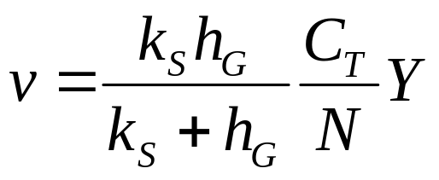
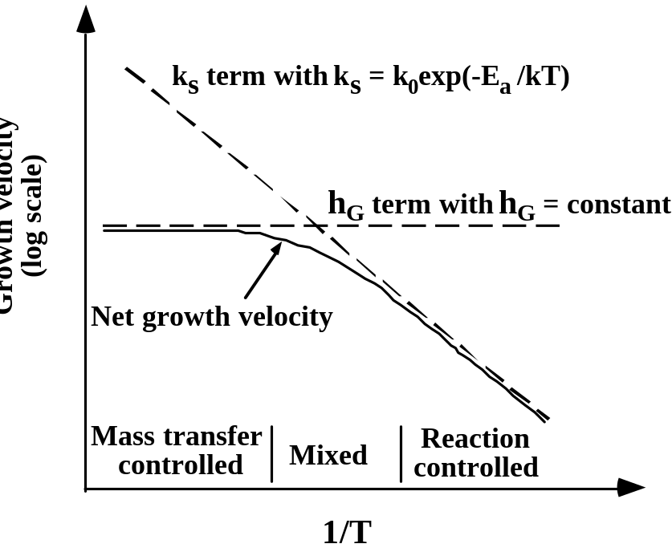
Mass transfer and surface reaction regimes
As for Si oxidation we observe 2 distinct growth regimes.
If kS << hG, then we have the surface reaction controlled case:
If hG << kS, we have the mass transfer, or gas phase diffusion, controlled case
Note that:
They are both linear with time ( reaction is always at the surface, not at Si/SiO₂ interface as in Si ox.)
K_{s} has an Arrhenius dependence on T
h_{G} shows little dependency on T

Slide 17
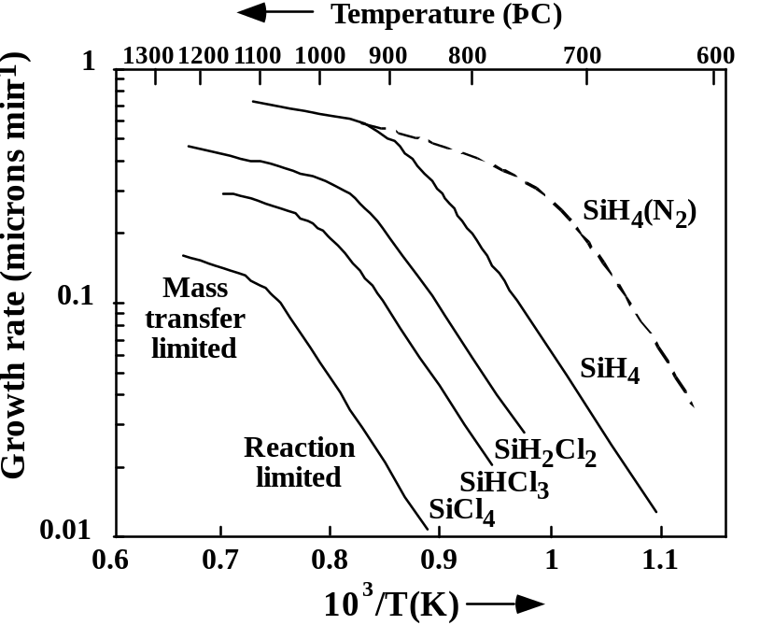
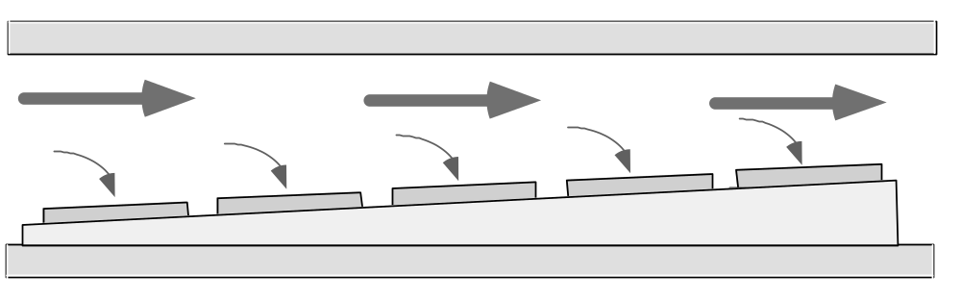
Mass transfer and surface reaction regimes
Key points:
k_{S} limited deposition is VERY temperature sensitive.
h_{G} limited deposition is VERY geometry (boundary layer) sensitive.
Example:
Si epi deposition often done at high T to get high quality single crystal growth→ h_{G} controlled → horizontal reactor configuration.
Bur remember that δ_{s} is not constant as a function of z !

Slide 18
Mass transport vs Surface reaction
Mass transport regime is very sensitive to boundary layer geometry:
  Special care must be put in assuring that the same reactant flow reach all the wafers an the whole wafer surface
  Uniformity (or throughput: wafer must placed side by side) problems may arise
A way to switch to surface reaction regime is lowering T, but:
  Very low deposition rates
  Poor film quality

Slide 19
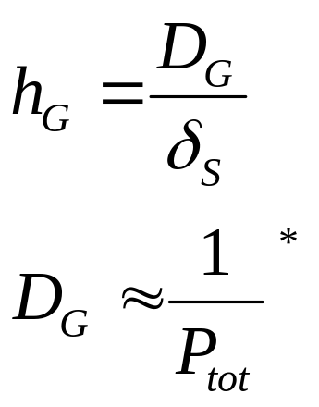
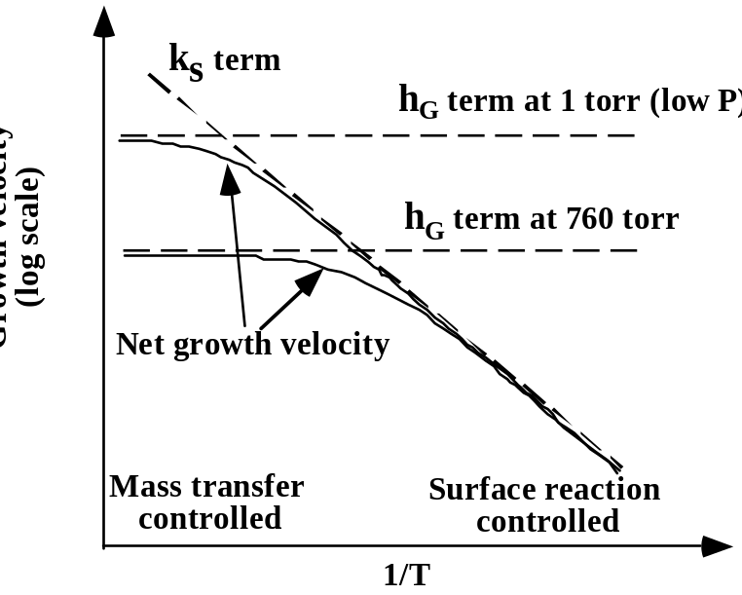
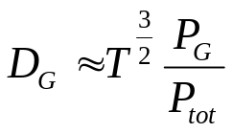
LPCVD
Reactant gas diffusivity
A way to move to surface reaction controlled regimes is lowering the pressure.
Low Pressure Chemical Vapour Deposition is now vastly diffused in IC manufacturing
* reported to be
Notes:
Dimostrare l’espressione per hg. Il flusso attraverso il boundary layer puo’ essere espresso come legge di Fick
F=-Dg dC/dx; ma dC/dX= (Cg-Cs)/δs → espressione per hg.
Dg non ha una dipendenza alla Ahrrenius dalla T → come mai ? (boh…sara’ perche siamo in fase gassosa ?)

Slide 20
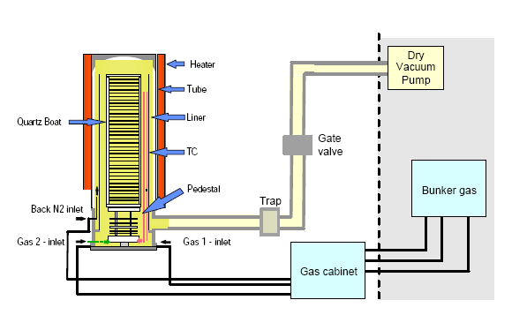
Advantages of LPCVD
  Wafers can be stacked
  Less autodoping
  Fewer gas phase reactions

Slide 21
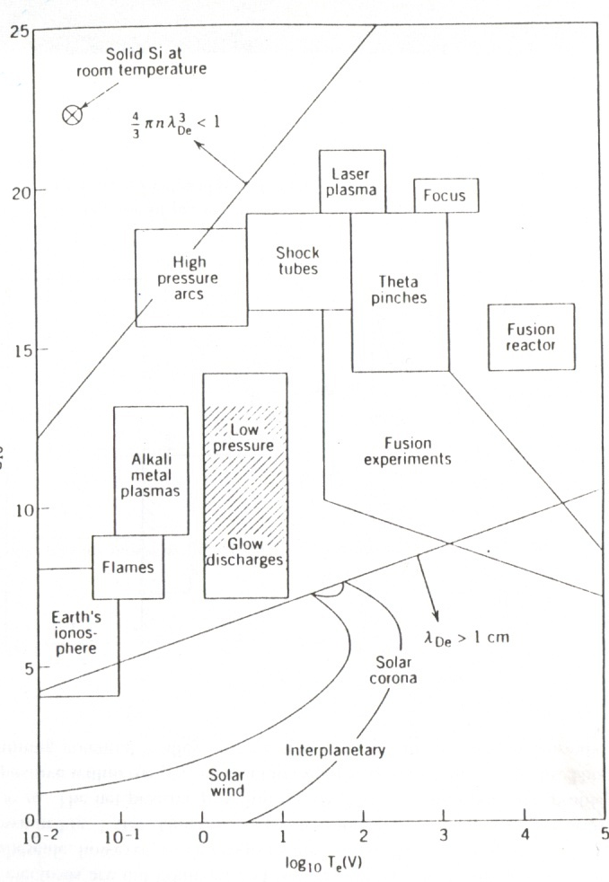
Plasma definition
<<A plasma is a collection of free charged particles moving in random directions that is, on the average, electrically neutral>>
If a gas is sufficiently heated, atoms decompose into freely moving electrons and ions
In this conditions, at equilibrium
n_{e}≈n_{i}≈n cm⁻³ and T_{e}=T_{i}=T
Typical temperature to form plasmas at thermal equilibrium range from 4000 to 20000 K
Much of the matter in the universe is in plasma state
Log₁₀n(cm⁻³)
Fig. 1.7 Lieberman pg 9

Slide 22
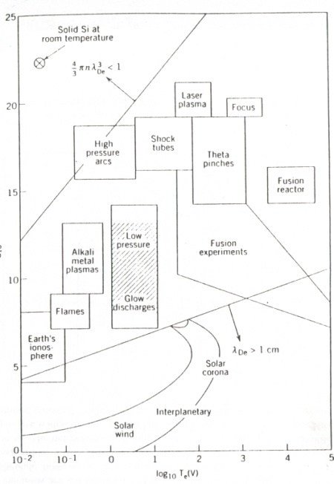
Plasma definition
We are interested in weakly ionized plasmas:
  Driven electrically
  Charged particles collision with neutral molecules are important
  Surface loss at boundaries is important
  Ionization of neutrals sustain the plasma in steady state
  Electrons are NOT in thermal equilibrium with ions
In typical low pressure glow discharges
    p ≈ 1mTorr – 1Torr
    T_{e} ≈ 1-10 V and T_{e}>>T_{i}
    n ≈ 10⁸-10¹³ cm⁻³
Log₁₀n(cm⁻³)

Slide 23
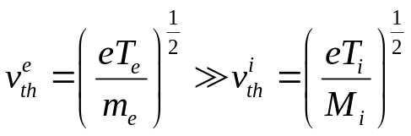
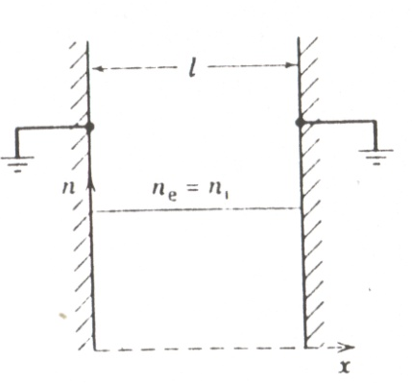
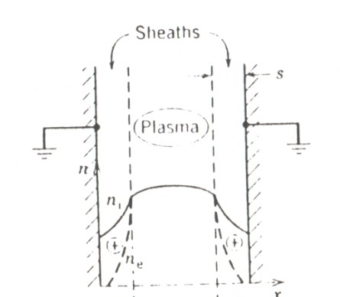
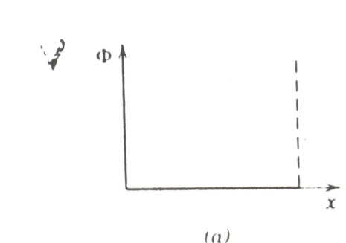
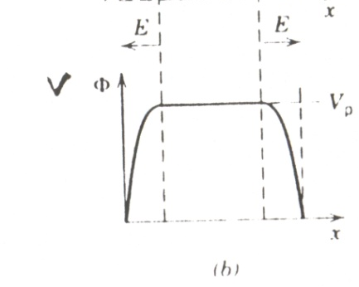
Sheaths
Plasmas are joined to wall surfaces by thin positive charged layers → sheaths
Remember that
>>
Moreover: net charge density is 0, and the electric field is zero everywhere → electrons are not confined
  Faster electrons are lost at the walls in a very short time scale
  An electric field builds up to opposite the imbalance between ion and electron currents.
  Plasma bulk has a positive potential with respect to confining walls

Slide 24
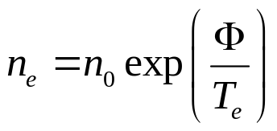
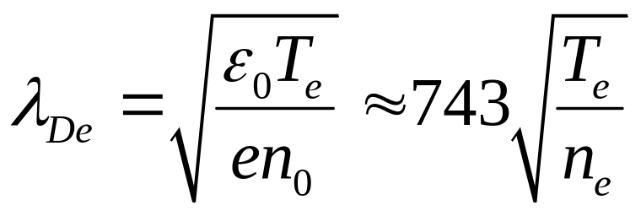
Boltzmann’s relation and Debye length
Boltzmann’s relation describes the density of electrons in thermal equilibrium at varying positions in a plasma under the action of a spatially varying potential
Where: n_{e} is the electron density, Φ is the potential and T_{e} is the electron temperature, expressed in V.
Debye length is the typical length of scale in plasmas.
It could be defined as the distance over which significant charge densities can spontaneously exist. Plasmas remain neutral on distances larger than λ_{De}

Slide 25
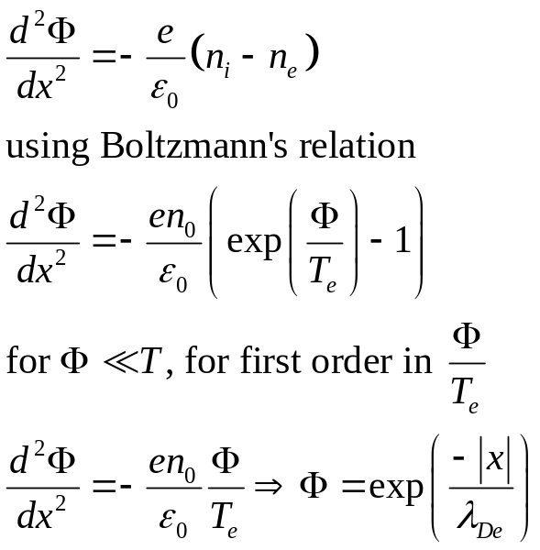
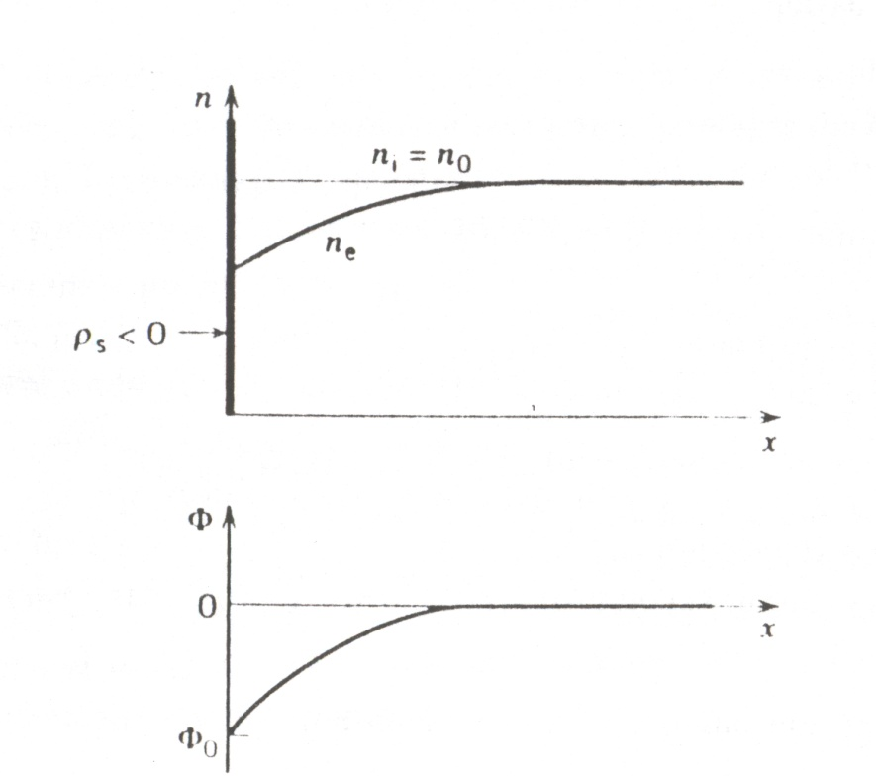
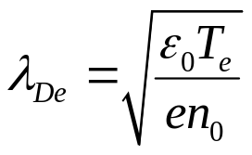
Debye Length calculation (optional)
Introduce a negative charge sheet in a plasma with n_{e}=n_{i}=n₀
Assume immobile ions after sheet introduction (n_{i} stays =n₀)
Negative charge sheet repels electrons. We can write Poisson’s equation as follows
Figura 2.5 Lieberman pg. 41

Slide 26
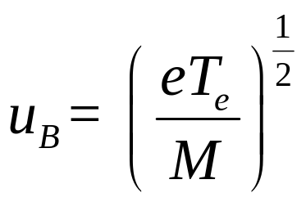
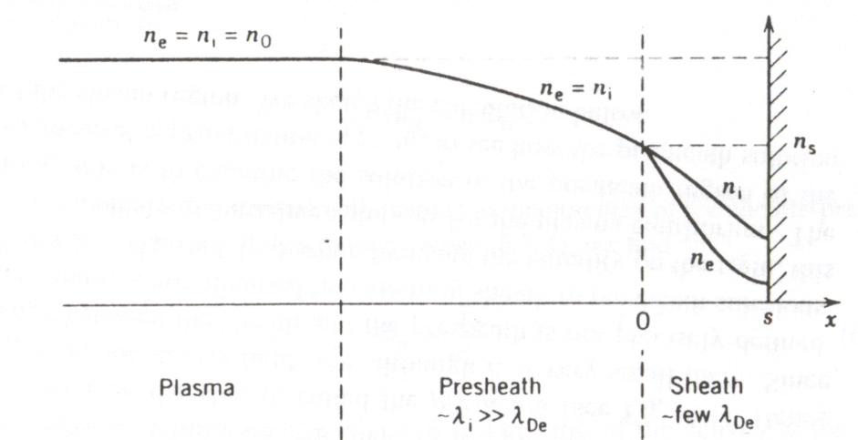
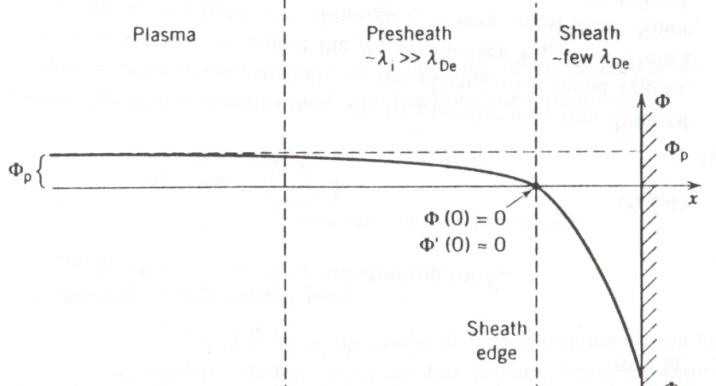
Sheath and pre-sheath
It can be demonstrated that ions enter the sheath with a velocity, called Bohm velocity that is
This implies that a pre-sheath exists where n_{e} still equals n_{i}, but a small electric field already exist.

Slide 27
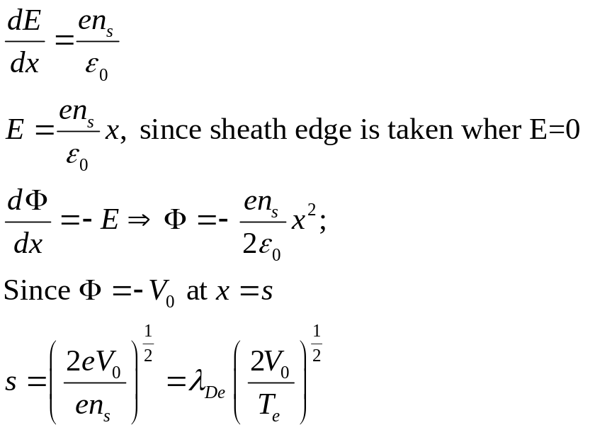
High voltage DC sheath: matrix sheath
If one of the plasma walls is driven to V₀>>T_{e}, then electron density is basically zero in the sheath (n_{e}=n_{s}exp(Φ/T_{e})→0) and only ions are present.
The simplest approach is letting n_{i}=n_{s}=const.
This description is not consistent in steady state, since ion density decrease while ions are accelerating in the sheath potential.

Slide 28
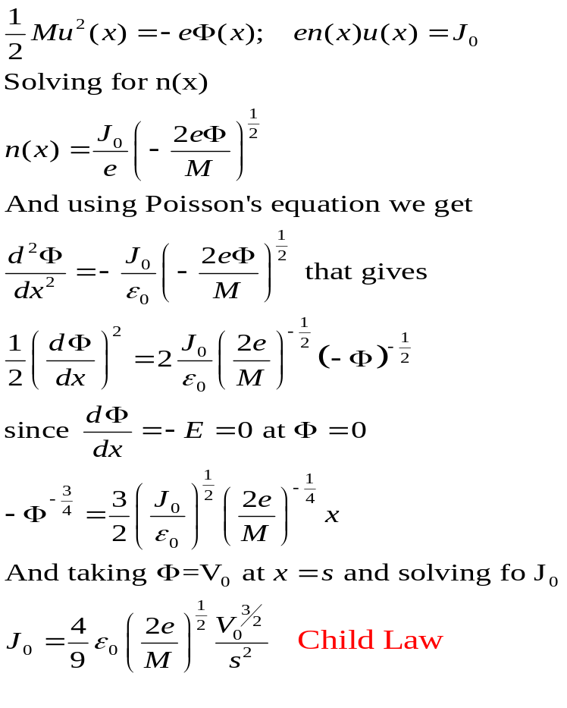
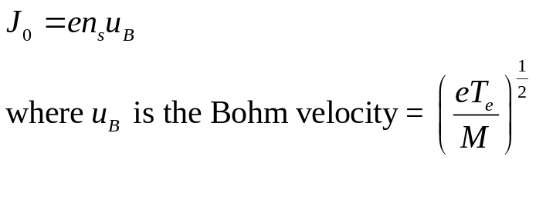
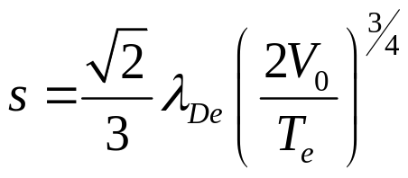
High voltage DC sheath: Child law sheath (optional)
We can refine the previous model by imposing a constant ion current J₀; if the initial energy of the ions is small compared to the applied potential, then we can write energy and flux conservation as:
Remembering that
We can derive a new expression for the sheath thickness s

Slide 29
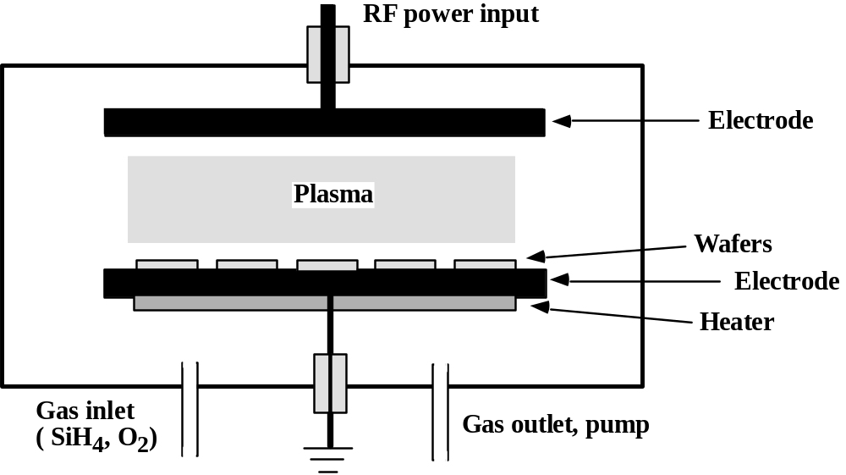
Plasma Enhanced CVD (PE-CVD)
Non-thermal energy to enhance processes at lower temperatures.
Plasma consists of electrons, ionized molecules, neutral molecules, neutral and ionized fragments of broken-up molecules, excited molecules and free radicals.
Free radicals are electrically neutral species that have incomplete bonding and are extremely reactive. (e.g. SiO, SiH3, F)
The net result from the fragmentation, the free radicals, and the ion bombardment is that the surface processes and deposition occur at much lower temperatures than in non-plasma systems.

Slide 30
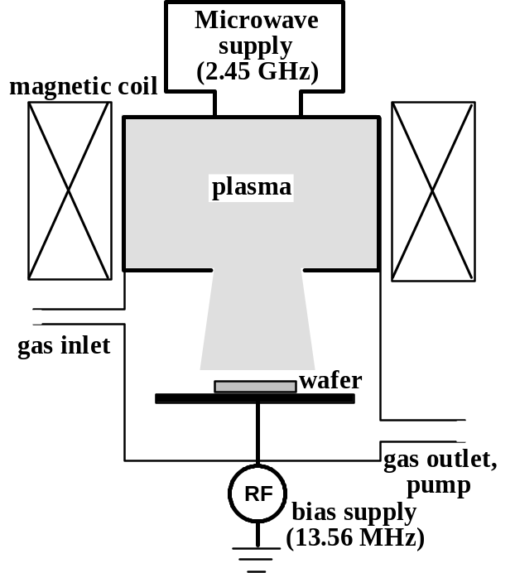
High Density Plasma CVD (HDP-CVD)
Remote high density plasma with independent RF substrate bias.
Allows simultaneous deposition and sputtering for better planarization and void-free films.
Mostly used for SiO2 deposition.

Slide 31
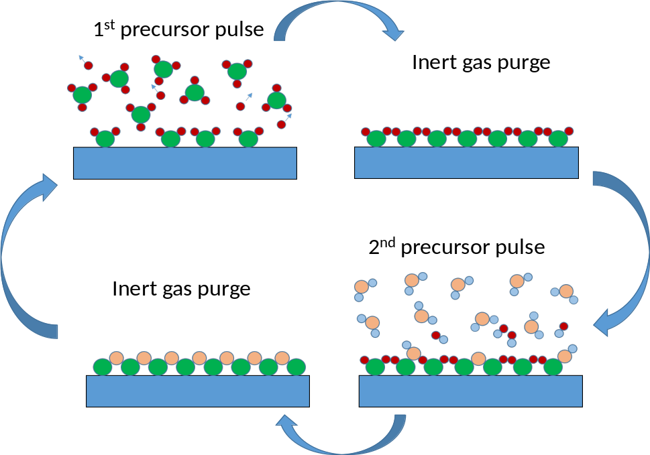
Atomic Layer Deposition (ALD)
Sequence of self-limitng surface reactions
Can be temperature, radical and plasma assisted
Atomic scale thickness control, very high step coverage
Typical application: DRAM capacitor High K oxides

Slide 32
Atomic Layer Deposition (ALD)
Conformality: Provided that the precursors dose is large enough to saturate all the surface reaction site, the self-limited growth regime guarantees excellent conformality and a uniform growth on structured substrates. This is why ALD is the deposition technique of choice for the deposition of high-k dielectrics in scaled DRAM capacitors, usually consisting in cylindrical containers with very high aspect ratio (up to 100:1).
Composition control: With its mono-layer growth capability, ALD offers an intrinsically high degree of control on film composition. Dopants can be introduced by alternating different precursors in different cycles, and nano-laminates film structures can be easily grown.
Thermal budget: The temperatures required in ALD processes can be significantly lower when compared to standard CVD depositions, the typical temperature range being between 200 and 350 °C. (thermal budget can be lower for PE-ALD)

Slide 33
Some CVD films
Film | Equipment | Reactions | T
EPI-Si | APCVD, LPCVD | SiH₄→Si+2H₂ (HCl can be added for selective processes) SiCl₄+2H₂→Si + 4HCl | 700/1250 C
Poly-Si | LPCVD | Same | 575/650 C Grain structure depends on T and doping. Amorphous film below 570 C
Silicon Nitride | LPCVD< PECVD | 3SiH₄+NH₄→Si₃N₄ + 12H₂ | (30)200/800 C
SiO₂ | LPCVD, PECVD, HDPCVD, APCVD | SiH₄+O₂→SiO₂+2H₂ Si(OC₂H₅)₄+(O₃₎ | 25/800 C
W | LPCVD | 2WF₆+3SiH₄→2W +3SiF₄+6H₂ WF₆+3H₂→W+6HF | 250/500 C

Slide 34
Bibliography for this lesson
J.D. Plummer, “Silicon VLSI technology. Fundamentals, practice and modeling” , Prentice Hall 2000
S.A. Campbell, “The science and engineering of microelectronic fabrication”, Oxford University Press 2001
M. Alonso, E.J. Finn, “Elementi di Fisica per l’Universitá”, Masson/Addison Wesley 1993
M.A. Lieberman, A.J. Lichtenberg, “Principles of plasma discharges and materials processing”, Wiley-Interscience 2005
Marcello Mariani, " Front-End Processes", in Robert Puers (Editor), Livio Baldi (Editor), Marcel Van de Voorde (Editor), Sebastiaan E. van Nooten (Editor) "Nanoelectronics: Materials, Devices, Applications", Wiley 2017.

